Slide 1



Smart Health Monitoring System
(Hot shots)

Slide 2

Smart Health Monitoring System
The Smart Health Monitoring System is an advanced predictive analytics tool designed to continuously monitor and analyze patient data such as heart rate, activity levels, sleep patterns, and more. By leveraging machine learning algorithms and real-time data processing, the system forecasts potential health issues and alerts both healthcare providers and patients proactively.
The Smart Health Monitoring System is an advanced predictive analytics tool designed to continuously monitor and analyze patient data such as heart rate, activity levels, sleep patterns, and more. By leveraging machine learning algorithms and real-time data processing, the system forecasts potential health issues and alerts both healthcare providers and patients proactively.
>Proactive Health Management
This system transitions from reactive to proactive health monitoring by identifying early warning signs of health issues, enabling timely interventions.
>Enhanced Patient Engagement
By delivering insights into health data, it empowers patients to actively manage their well-being.
>Proactive Health Management
This system transitions from reactive to proactive health monitoring by identifying early warning signs of health issues, enabling timely interventions.
>Enhanced Patient Engagement
By delivering insights into health data, it empowers patients to actively manage their well-being.

Slide 3
Smart Health Monitoring System
KEY FEATURES:
>Real-Time Monitoring: Tracks vital signs and activities through wearables or apps.
Machine Learning Algorithms: Detects patterns in historical data to predict health risks.
>Customizable Dashboard: Offers personalized health metrics for easy understanding.
>Automated Alerts: Notifies patients and providers of anomalies or concerning patterns.
>Integration with Healthcare Systems: Connects with existing EHR systems for comprehensive management.
>Data Privacy and Security: Utilizes encryption and complies with regulations to protect sensitive information.
KEY FEATURES:
>Real-Time Monitoring: Tracks vital signs and activities through wearables or apps.
Machine Learning Algorithms: Detects patterns in historical data to predict health risks.
>Customizable Dashboard: Offers personalized health metrics for easy understanding.
>Automated Alerts: Notifies patients and providers of anomalies or concerning patterns.
>Integration with Healthcare Systems: Connects with existing EHR systems for comprehensive management.
>Data Privacy and Security: Utilizes encryption and complies with regulations to protect sensitive information.
Benefits:
Improved Patient Outcomes: Early detection and intervention can lead to better health outcomes and reduced hospital admissions.
Increased Efficiency: Healthcare providers can prioritize patients based on predictive alerts, optimizing their workflow and resource allocation.
Empowered Patients: Access to real-time insights fosters greater patient involvement in their own care, leading to healthier lifestyle choices.
Cost Reduction: By preventing serious health issues through early intervention, the system can help reduce overall healthcare costs.
Benifits:
Improved Patient Outcomes: Early detection and intervention can lead to better health outcomes and reduced hospital admissions.
Increased Efficiency: Healthcare providers can prioritize patients based on predictive alerts, optimizing their workflow and resource allocation.
Empowered Patients: Access to real-time insights fosters greater patient involvement in their own care, leading to healthier lifestyle choices.
Cost Reduction: By preventing serious health issues through early intervention, the system can help reduce overall healthcare costs.

Slide 4
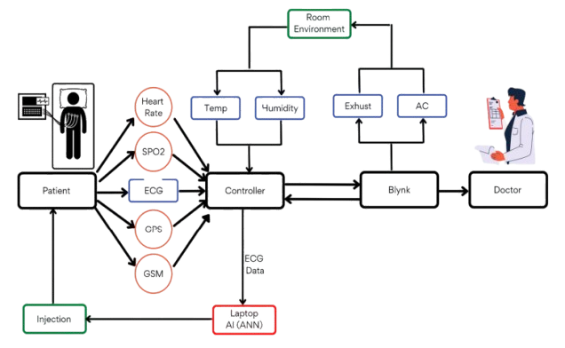
TECHNICAL ARCHITECTURE
Flowchart:
Tech stack
Frontend Technologies: (React or Angular)
Backend Technologies:(Flask or Django)
Database:(MySQL, Firebase)
Other Tools/Services:( Matplotlib or D3.js)

Slide 5
SCALABILITY AND FUTURE SCOPE
Real-Time Monitoring: Utilize scalable messaging systems for efficient real-time data processing.
Static Content Caching: Cache frequently accessed content to reduce load and improve response times.
Replication: Duplicate databases and services for improved availability and load balancing.
Content Delivery Network (CDN): Distribute content across geographically dispersed servers to reduce latency.
Testing and Load Simulation: Regularly conduct performance testing to identify bottlenecks and optimize resources.
Service Level Agreements (SLAs): Define performance benchmarks to ensure consistent service quality.

Slide 6
Technologies Supporting Scalability
Microservices: Enable independent scaling of different system components for flexibility.
Containerization: Use Docker and Kubernetes for consistent, scalable, and easily deployable services.
Serverless Computing: Leverage event-driven functions for efficient handling of variable workloads.
API Gateway: Manage and route requests, control access, and optimize traffic distribution.
Future Scope
Integration of AI for Predictive Analytics: Use machine learning to predict health issues based on data trends.
Expansion of Telehealth Services: Enhance remote consultations and data-sharing with healthcare providers.
Interoperability with Other Health Platforms: Facilitate seamless data exchange across various healthcare systems.
Global Deployment: Expand to new regions with localized versions, ensuring compliance with local regulations.

Slide 7
FEASIBILITY
Potential challenges and risks:
Data Privacy and Security
Risk: Collecting sensitive health data can lead to concerns about data breaches, unauthorized access, and misuse.
Accuracy and Reliability of Data
Risk: Inaccurate readings from wearable devices may cause incorrect diagnoses or false alarms, undermining user trust.
Integration with Existing Healthcare Systems
Risk: Compatibility issues can complicate integration with various electronic health record (EHR) systems and healthcare platforms.
Regulatory Compliance
Risk: Navigating complex regulatory requirements across different regions can be time-consuming and expensive.
Cost and Accessibility
Risk: High costs may limit accessibility, especially for lower-income users or those in developing regions.
Technical Issues and Device Compatibility
Risk: Users might face issues such as device malfunctions, connectivity problems, or compatibility issues across platforms.

Slide 8
Strategies for Overcoming Challenges:
Data Privacy and Security
Implement strong encryption protocols for data transmission and storage.
Regularly conduct security audits and updates to address vulnerabilities.
Accuracy and Reliability of Data
Use clinically tested, high-quality sensors and devices.
Provide guidelines for proper device usage and regular calibration.
User Adoption and Engagement
Design a user-friendly interface with clear instructions and visual feedback.
Offer customization options, goals, reminders, and alerts.
Integration with Existing Healthcare Systems
Collaborate with healthcare providers to ensure compatibility and data standardization.
Regulatory Compliance
Stay updated on local regulations and engage legal experts for compliance.
Collaborate with regulatory bodies during development to ensure adherence to standards.
Cost and Accessibility
Offer tiered pricing models to increase affordability.
Partner with insurance companies to subsidize costs.
Focus on scalable manufacturing and distribution to lower expenses.
Technical Issues and Device Compatibility
Provide 24/7 technical support and detailed troubleshooting resources.
Regularly update software to address bugs and improve performance.

Slide 9

>Team Details

Slide 10



Lakshmi Navya
Pantangi
23BEC7191
Jaya Sri
Prathapani
23MIC7020
Naga Sindhu
Pegallapati
23BEC7111
Satya Ruthwik
Yanamadala
23BEC7037

Slide 11

Thanks for Joining

